Slide 1
Sentiment Analysis On Twitter Using Naive Bayes & Support Vector Machine Algorithms
PROJECT GUIDE
Dr. A . M. SOWJANYA
(Associate Professor)
CS&SE P.BHARATH
D.NIKHIL
N.PAUL ROHITH
R.SREEKAR

Slide 2
Contents
ABSTRACT
WHY TWITTER
SENTIMENT ANALYSIS
DOMAINS
EXISTING SYSTEM
PROPOSED SYSTEM
SYSTEM REQUIREMENTS
UML DIAGRAMS
SAMPLE CODE
SCREENSHOTS

Slide 3
Abstract:
People generated large volume of data or online reviews can be very useful for assessing the knowledge to political parties.
In this project, the main idea is to develop workflow to integrate results produced y the two algorithms and present their best result.
Here we are reflecting public’s reviews about particular political leaders (Narendra Modi and Donald Trump).
Based on these results, the implementation technique uses classification algorithms to classify tweets.
Hence, sentiment analysis or opinion mining aims to detect positive/negative aspects of opinion.

Slide 4
Sentiment Analysis
Opinion mining or sentiment analysis is computational study of people’s opinions, attitudes and emotions towards an entity.
The difference between them is that opinion mining extracts and analyses people’s opinion about an entity while sentiment analysis identifies a sentiment expressed in a text and then analyses it.

Slide 5
Why Twitter ?
Amount of relevant data is much larger in twitter, as compared to traditional blogging sites
Twitter is accessible for general people other than bloggers
Why not other blogging sites??
The main reason is, all the other sites have confidentially of the accounts where as twitters can access all the accounts using the token keys.

Slide 6
Domains
Inferential statistics
Text mining
Presidential and prime minister nominations
Election result prediction using tweets
Qualitative analysis on the tweets taken from twitter

Slide 7
Flow of project
Tweets extraction
Data cleaning
Apply algorithms
1. Classification of emotions
2. Classification of polarity
Predict the results
Compare the results

Slide 8
Existing Systems:
The existing system works only on the data set which is constrained to a particular topic.
Some sentiment analysis are performed by analysing the twitter posts about a specific domain using machine learning approach.

Slide 9
Proposed System:
In the proposed system, we have applied two algorithms for performing sentiment analysis.
The two algorithms are Naive Bayes algorithm and SVM(Support Vector Machine).
From the results obtained by both the algorithms, we determined which algorithm gives accurate results and is better in performance.

Slide 10
System Requirements:
Minimum Hardware Requirements:
RAM: 4GB
Hard disk: 4GB
Software Requirements:
1. R programming3.4.2
2. R Studio1.1.383

Slide 11
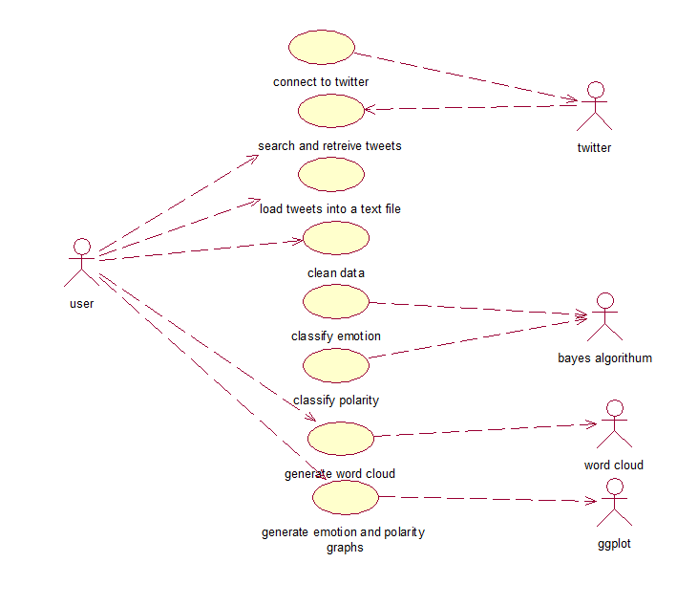
UML Diagrams Use case diagram

Slide 12
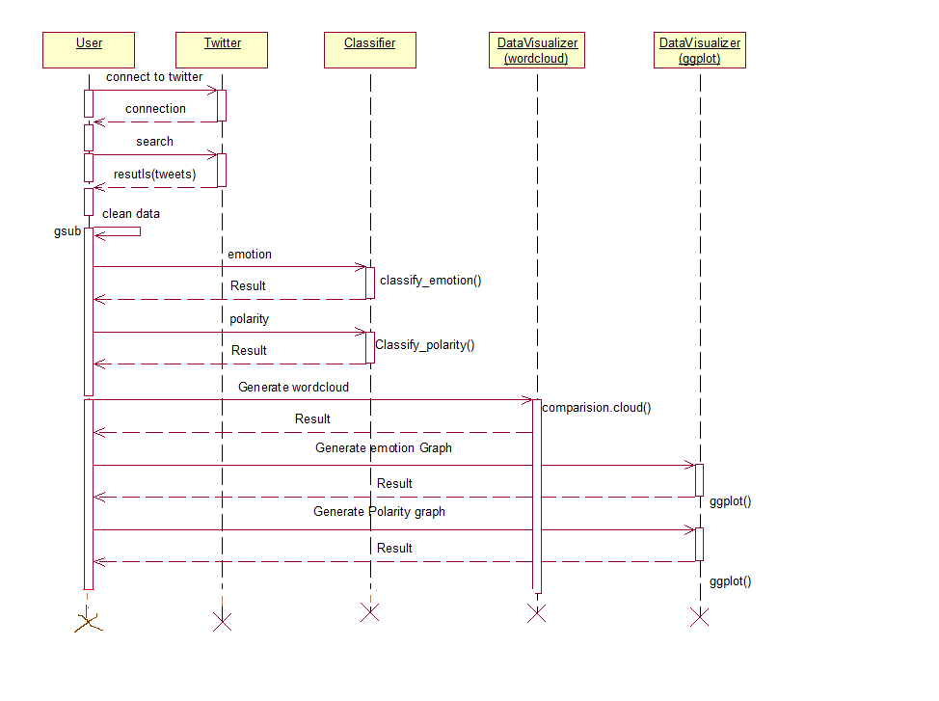
Sequence diagram

Slide 13
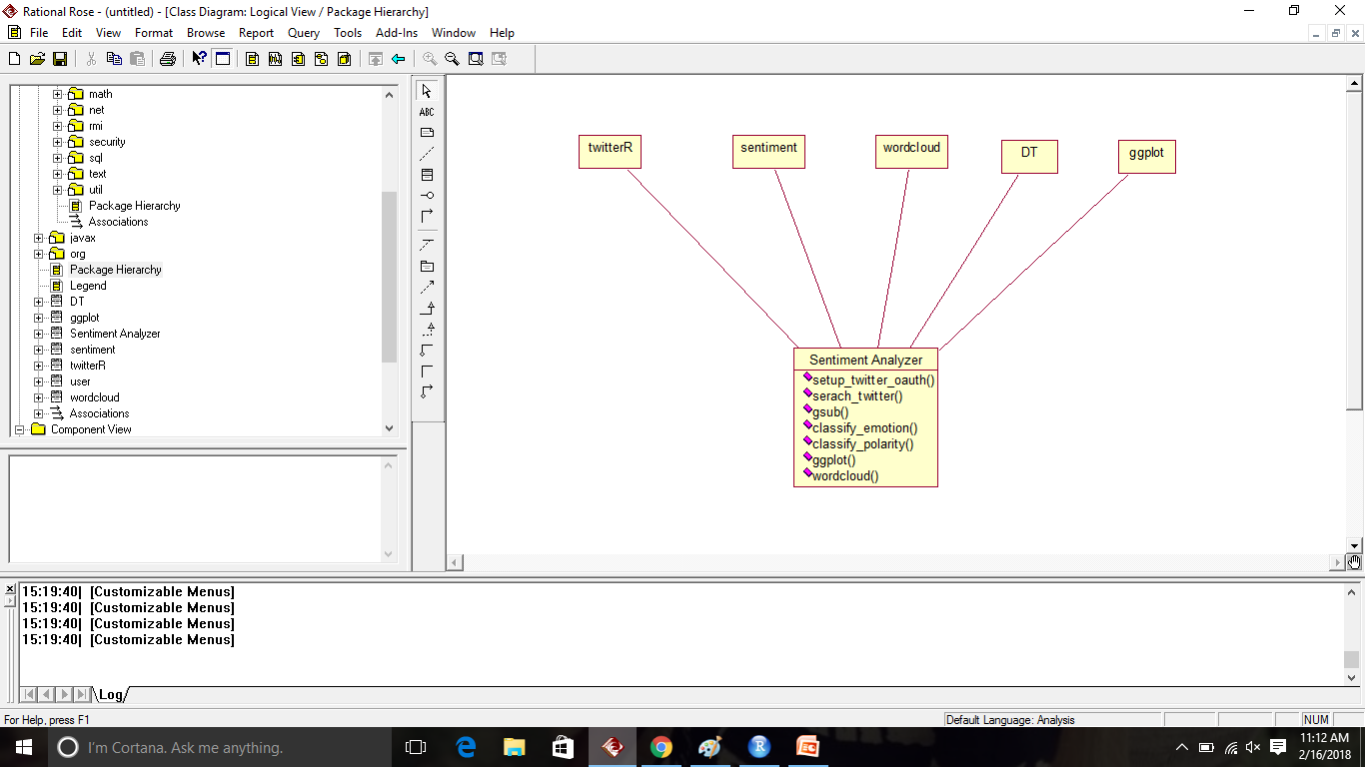
Class diagram

Slide 14
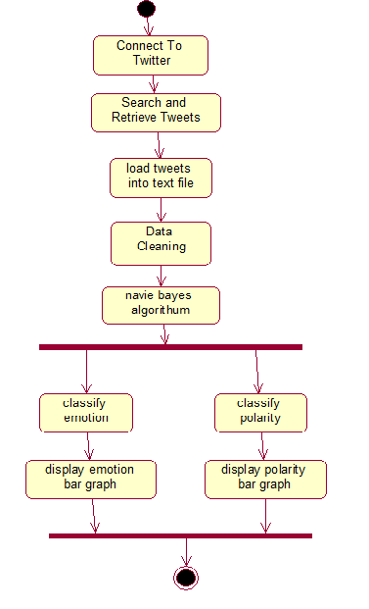
Activity Diagram

Slide 15
Creating Twitter API
We need to have a Twitter account to obtain credentials (i.e. API key, API secret, Access token and Access token secret) on the Twitter developer site to access the Twitter API.
Create a Twitter user account if you do not have one.
Go to www.twitter.com and log in with your Twitter user account. This step gives you a Twitter dev account.
Click “Create New App”.
Fill out the form, agree to the terms, and click “Create your Twitter application”.

Slide 16
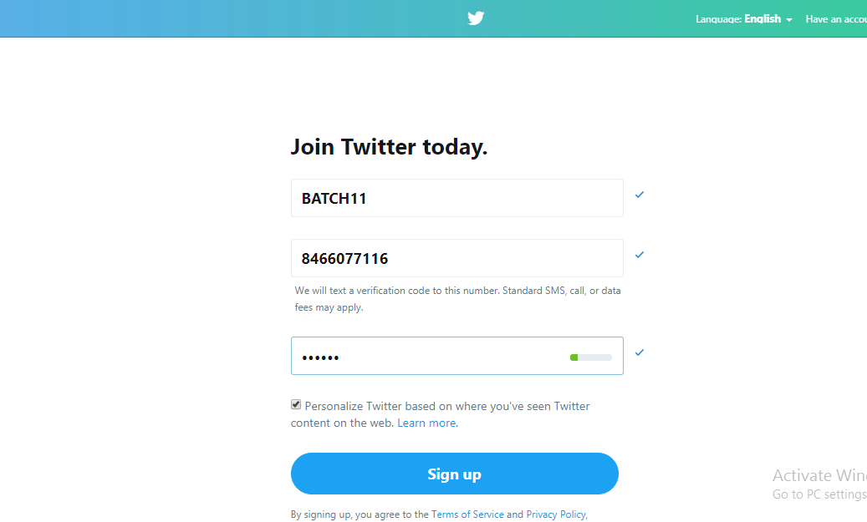
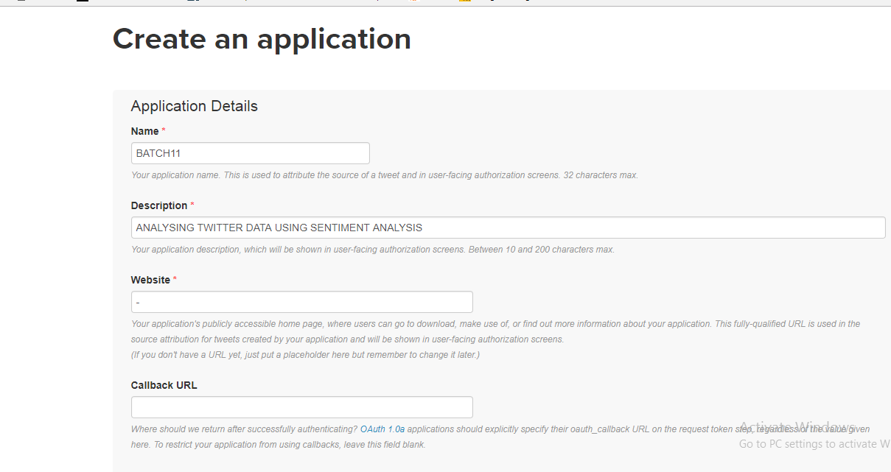
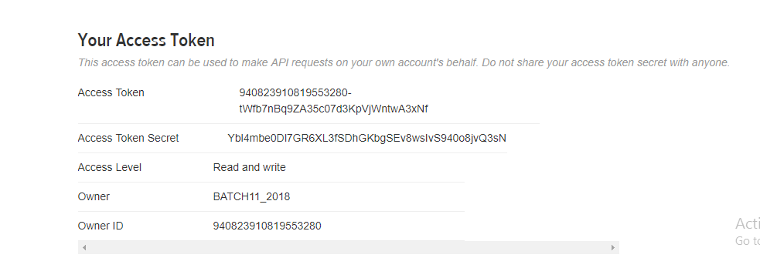
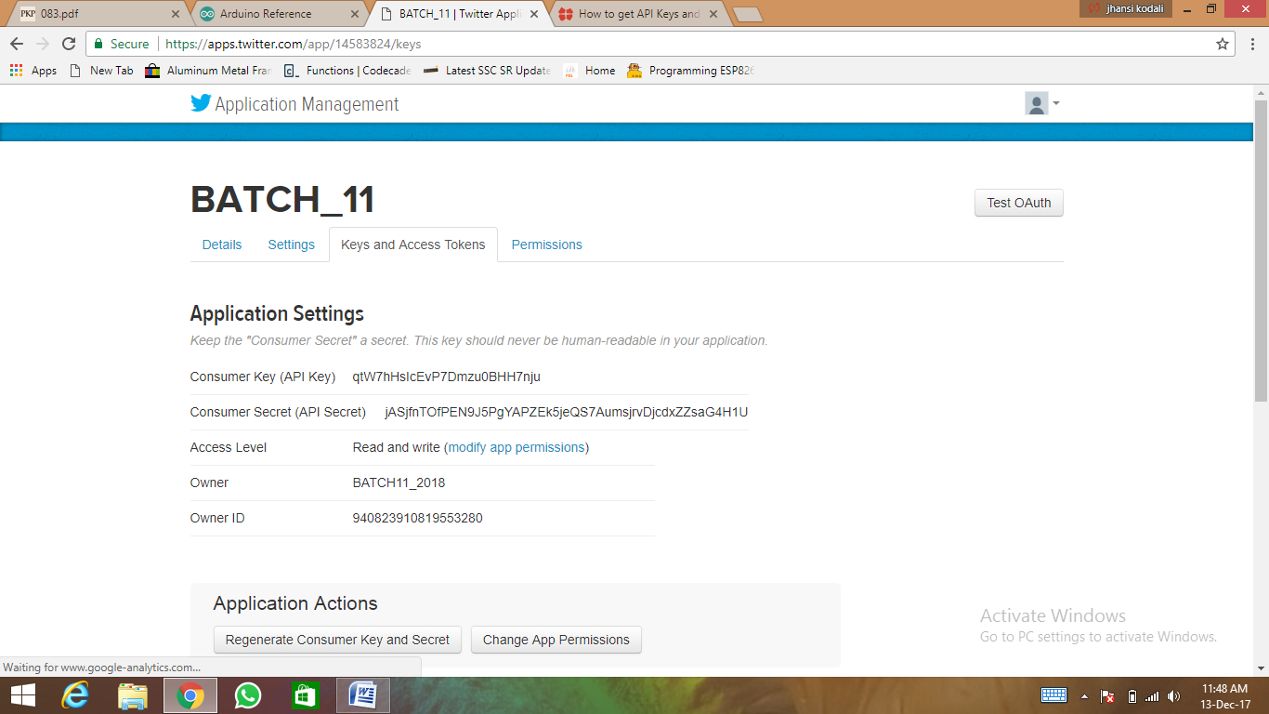

Slide 17
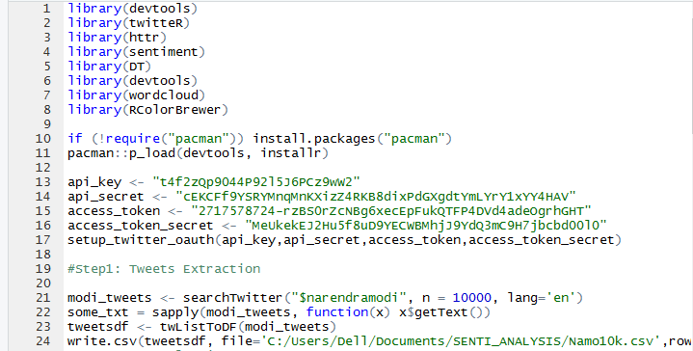
Extraction of Tweets

Slide 18
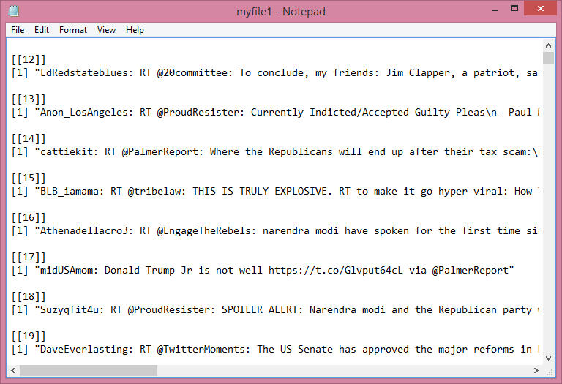
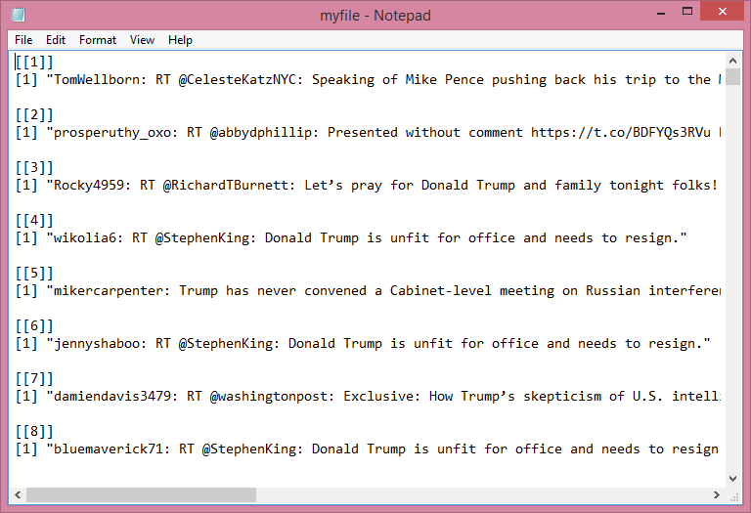
Tweets of Donald Trump and Narendra Modi

Slide 19
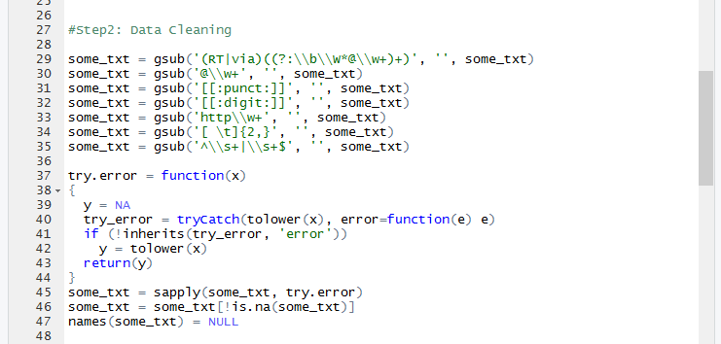
Data cleaning

Slide 20
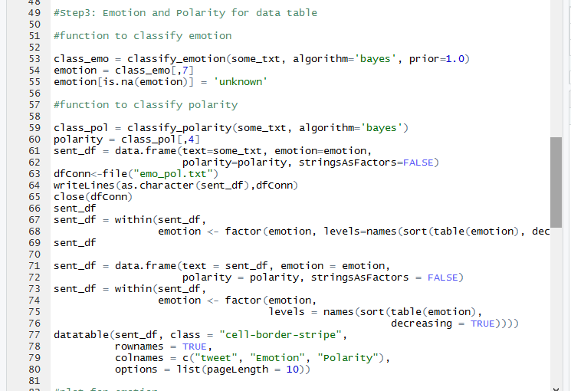
Generating data tables

Slide 21
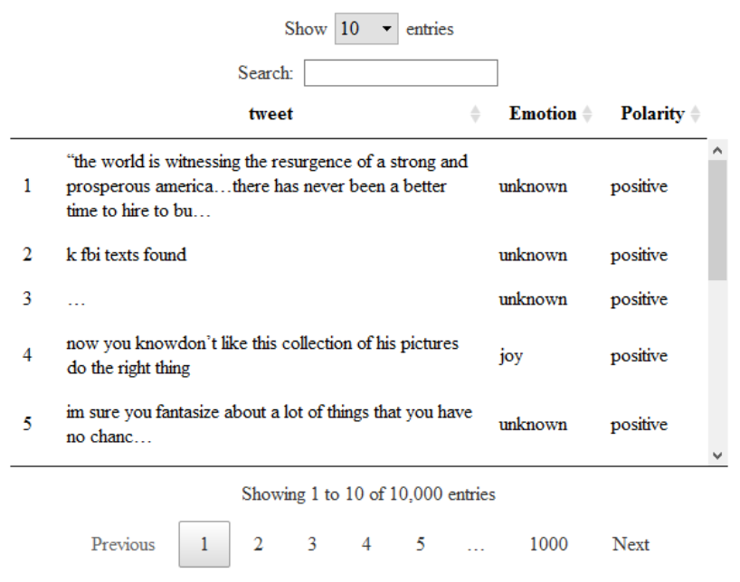
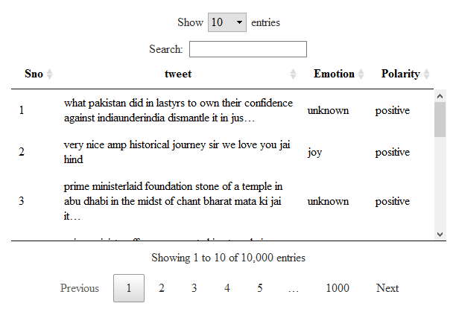
Data tables of Donald Trump and Narendra Modi

Slide 22
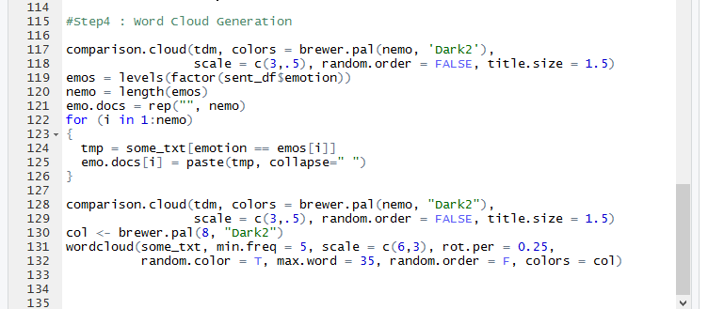
Word cloud generation

Slide 23
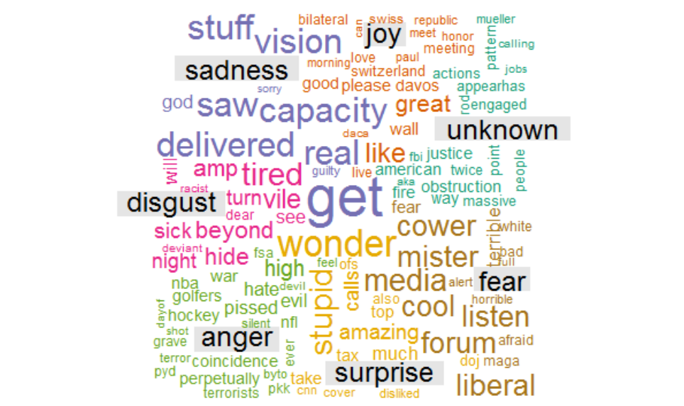
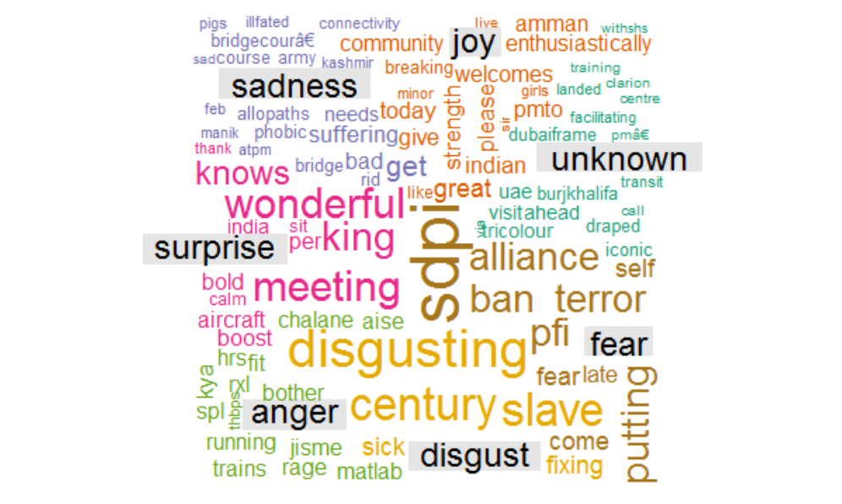
Word clouds of Donald Trump and Narendra Modi

Slide 24
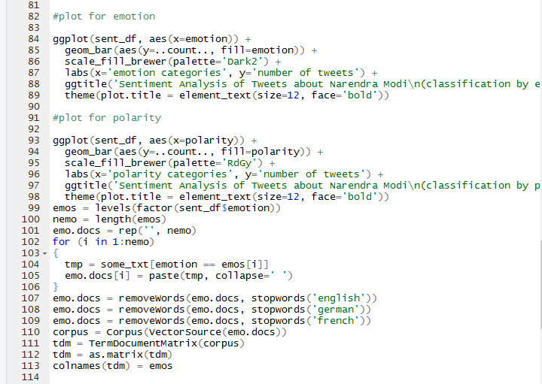
Emotion and Polarity

Slide 25
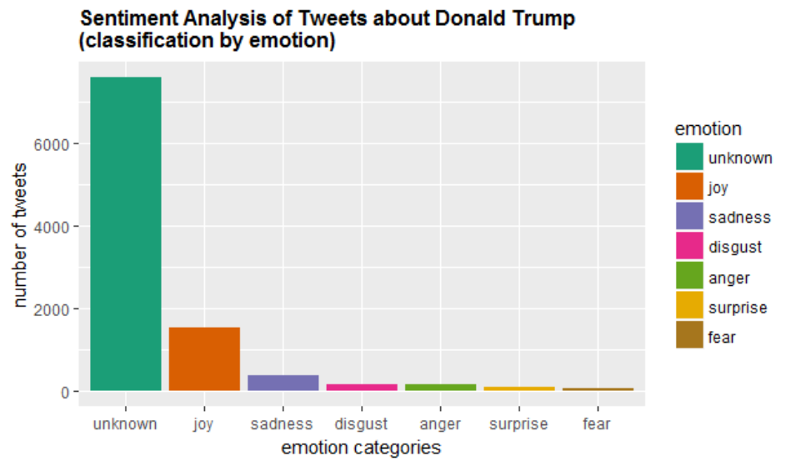
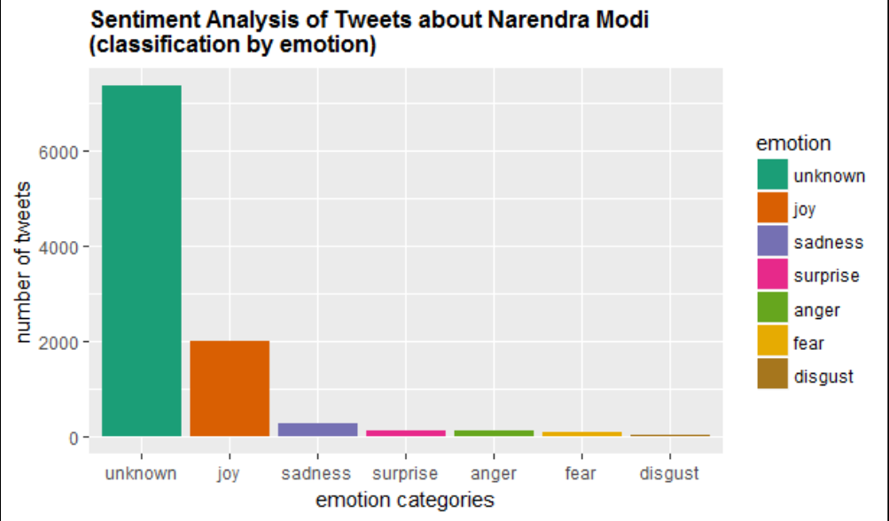
Emotion graphs of Donald Trump and Narendra Modi

Slide 26
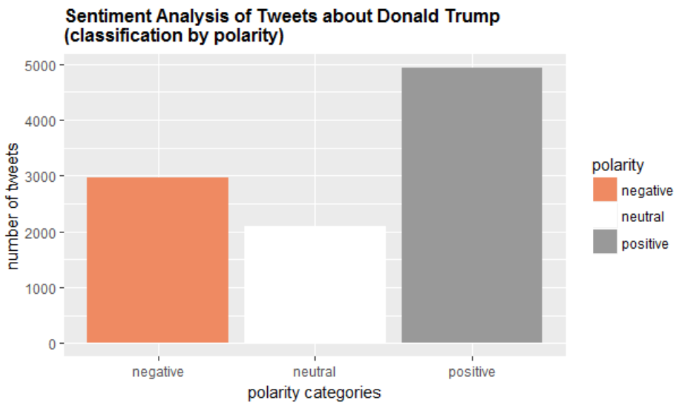
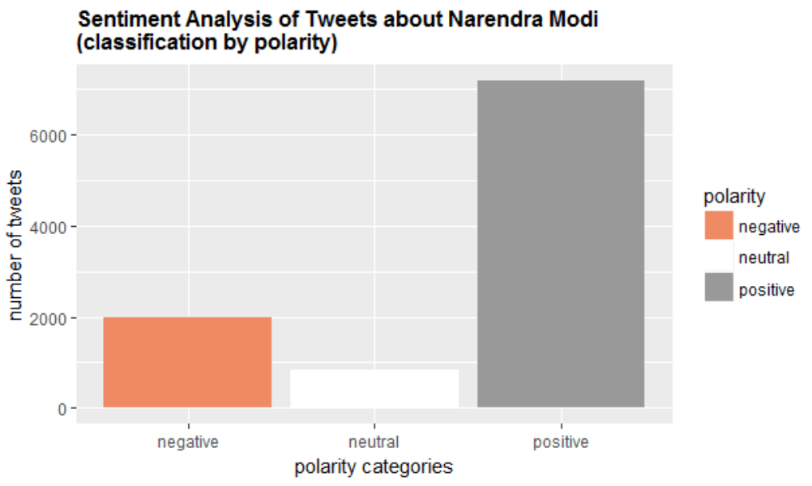
Polarity graphs of Donald Trump and Narendra Modi

Slide 27
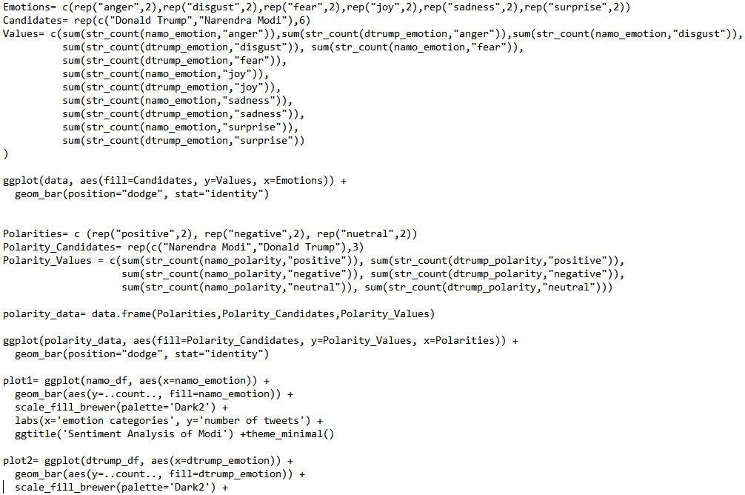
Integration code

Slide 28
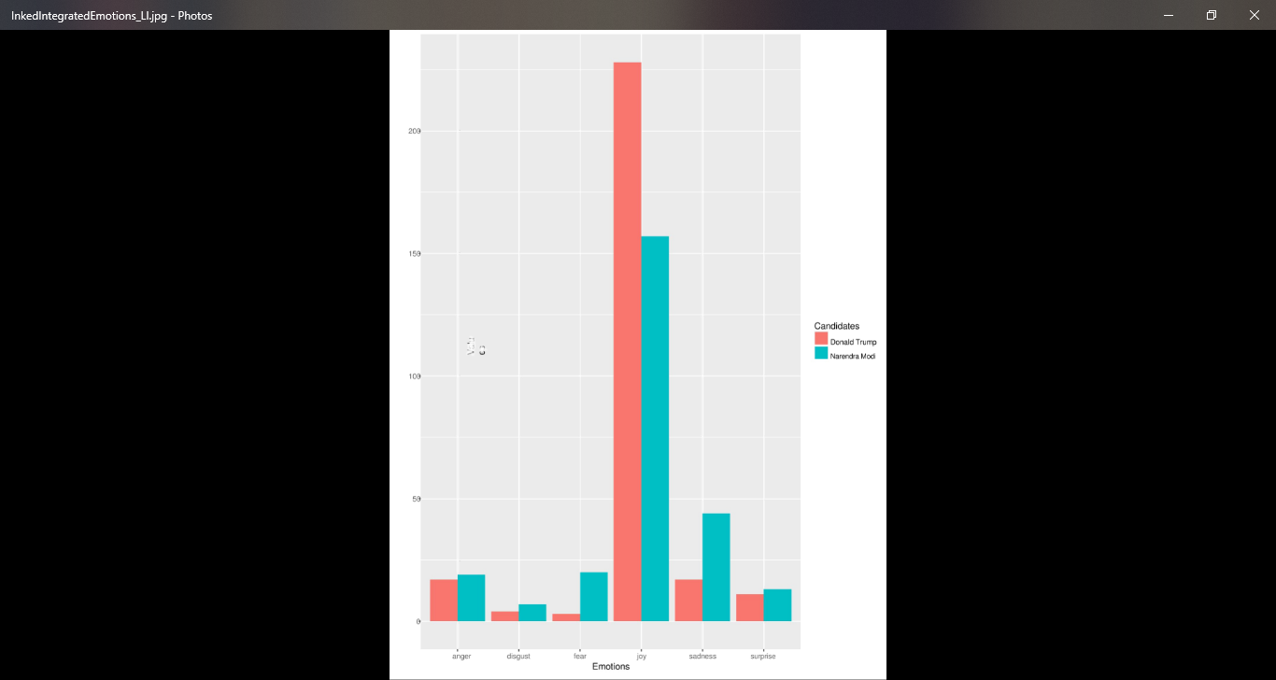
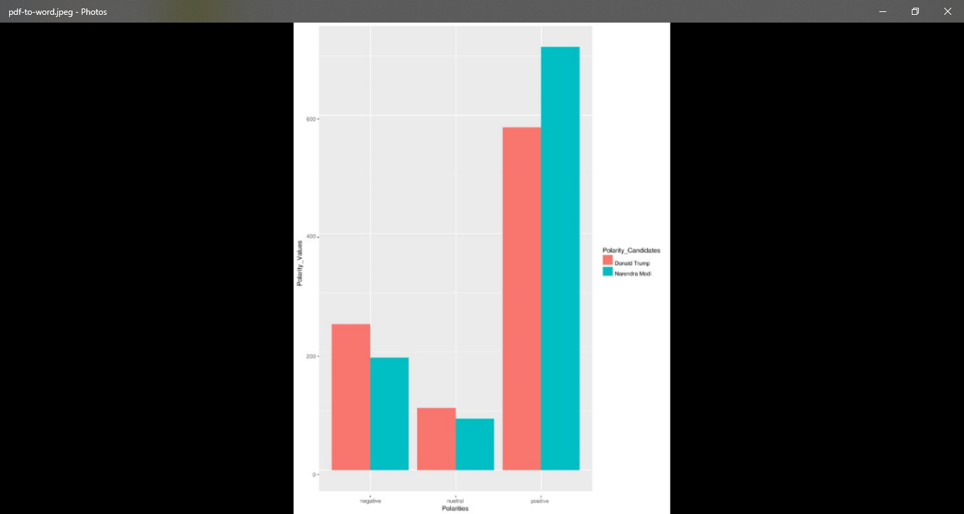
Integrated emotion and polarity graphs of Narendra Modi and Donald Trump

Slide 29
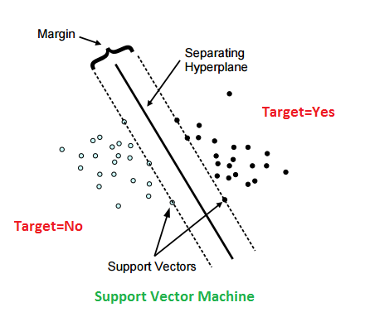
Algorithm used(SVM)
In SVM algorithm data is divided into classes. Based on the number of classes the hyper planes are drawn.
The criteria which we give are considered as the margins.
The points which satisfy the criteria are called support vectors.

Slide 30
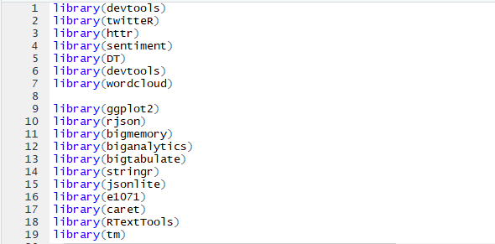
SVM Code

Slide 31
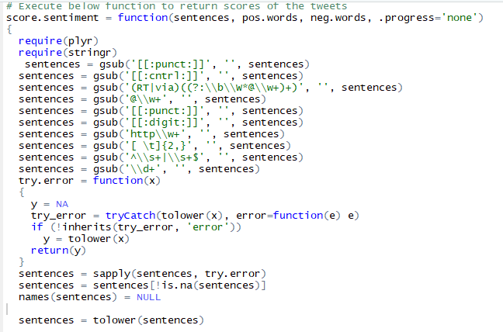
Data Cleaning

Slide 32
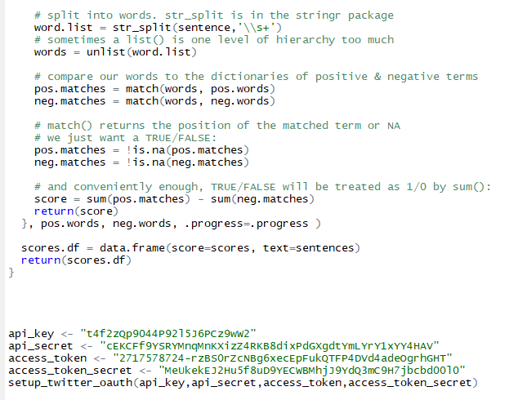
Score Function

Slide 33
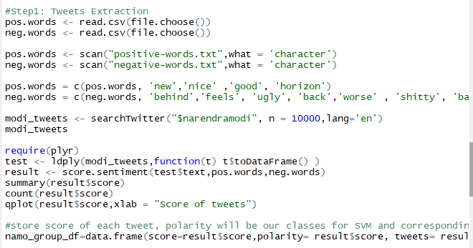
Tweet extraction and score plot

Slide 34
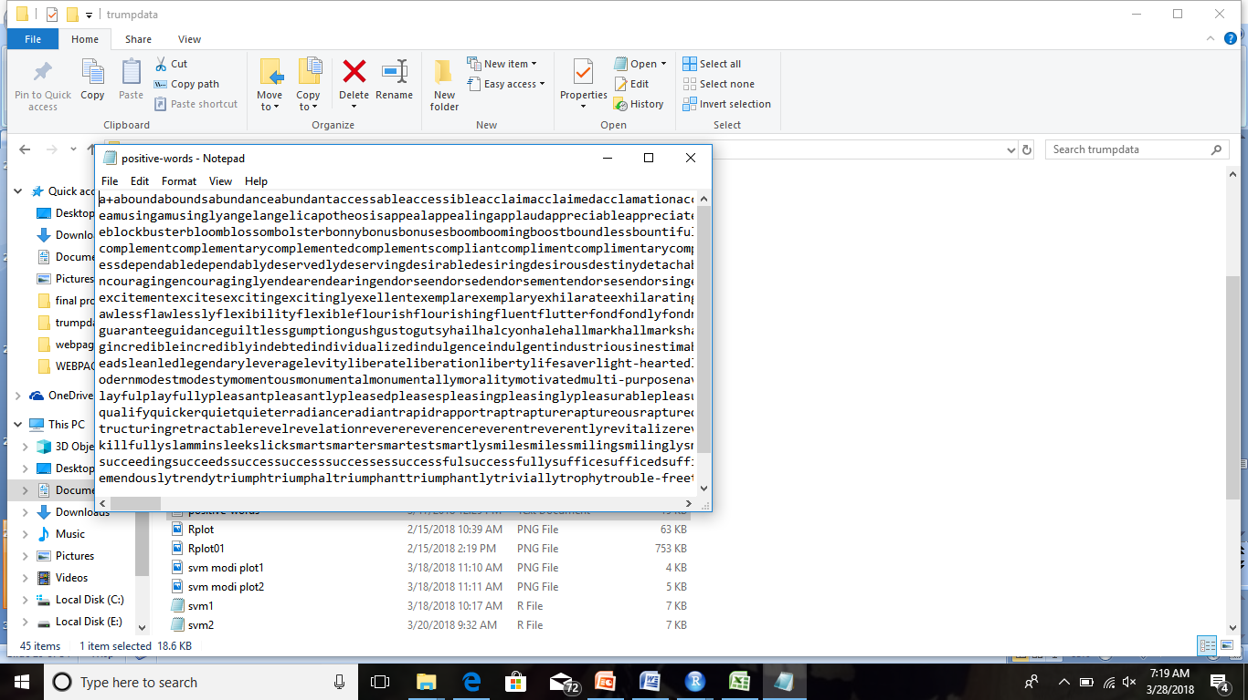
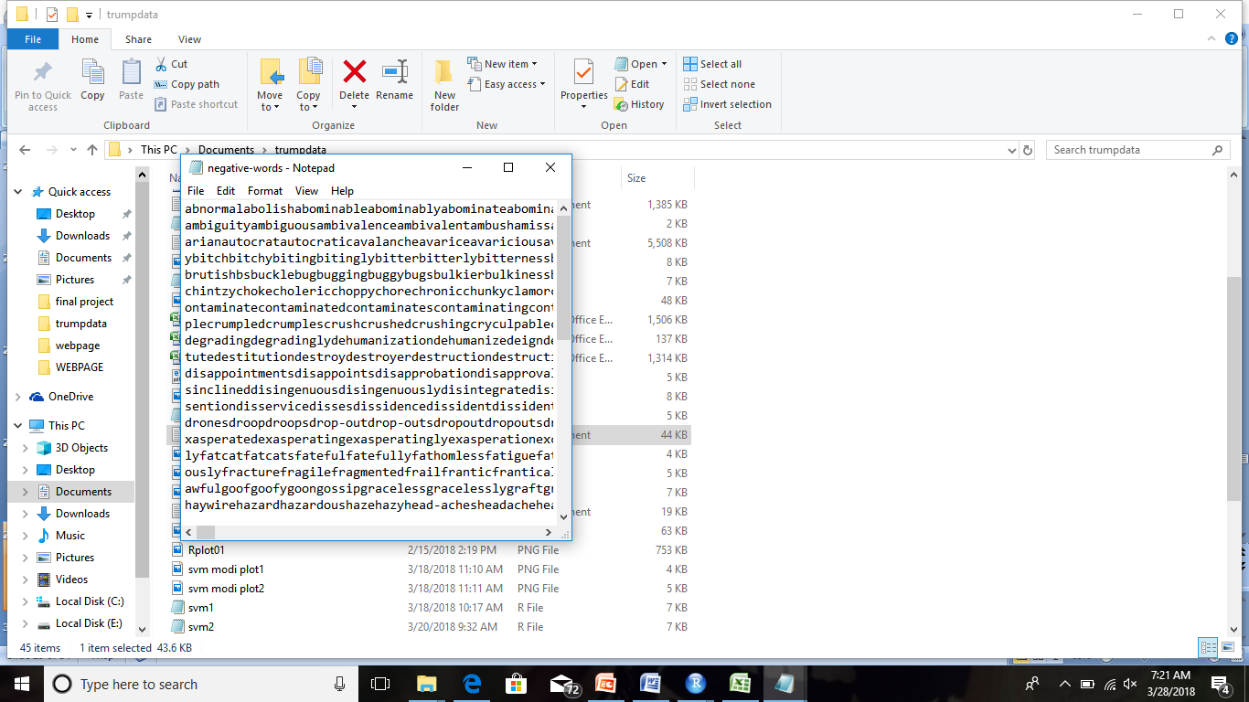
Positive and negative words list

Slide 35
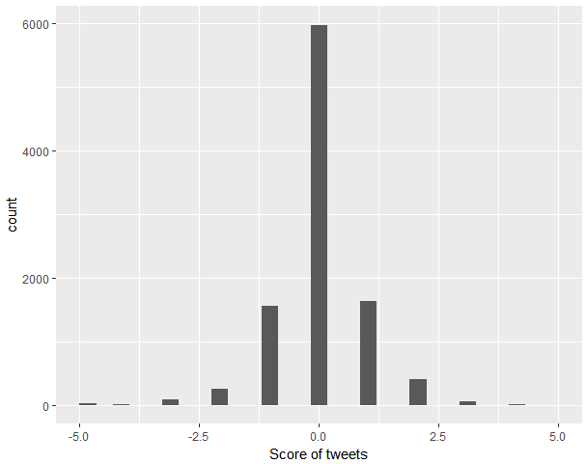
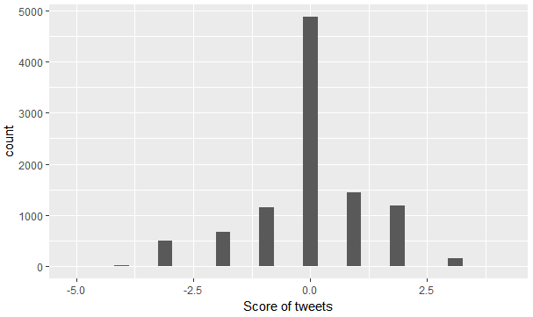
Score Plots of Narendra Modi and Donald Trump

Slide 36
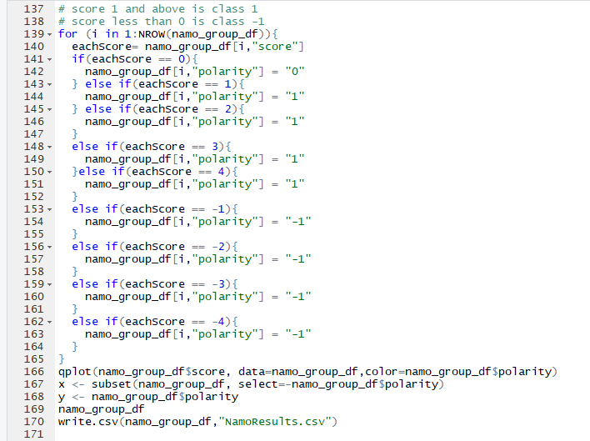
Score Calculation for Polarity

Slide 37
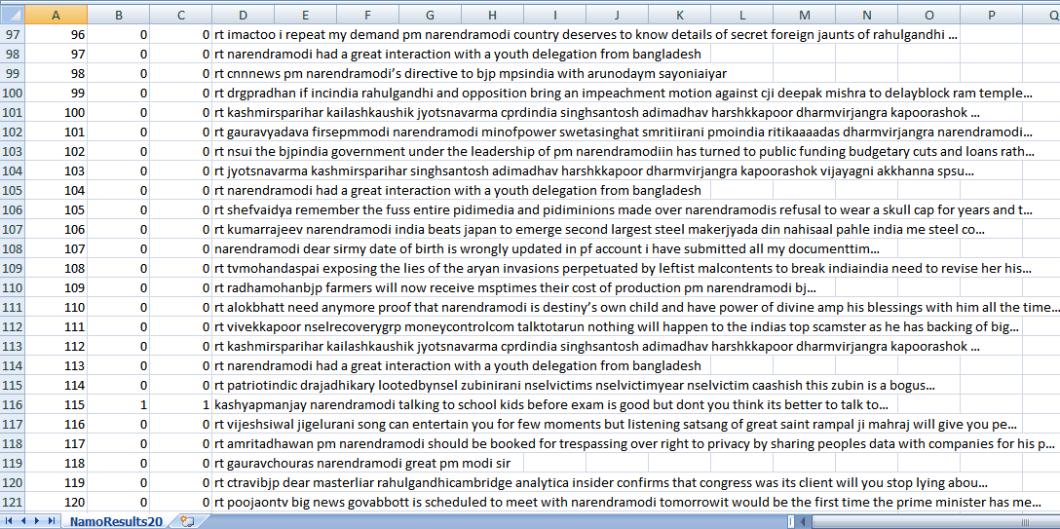
Tweets , scores and polarity file

Slide 38
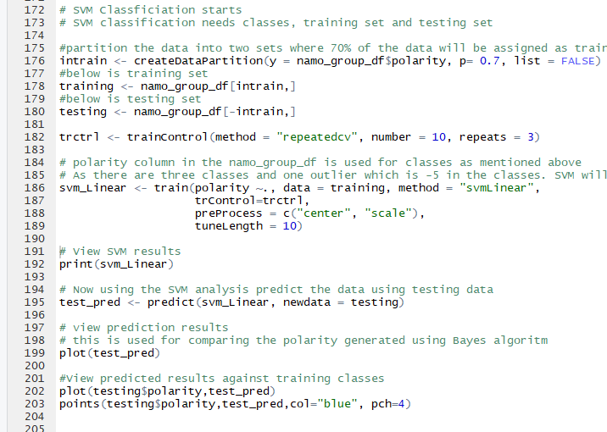
Performing SVM Algorithm on the data

Slide 39
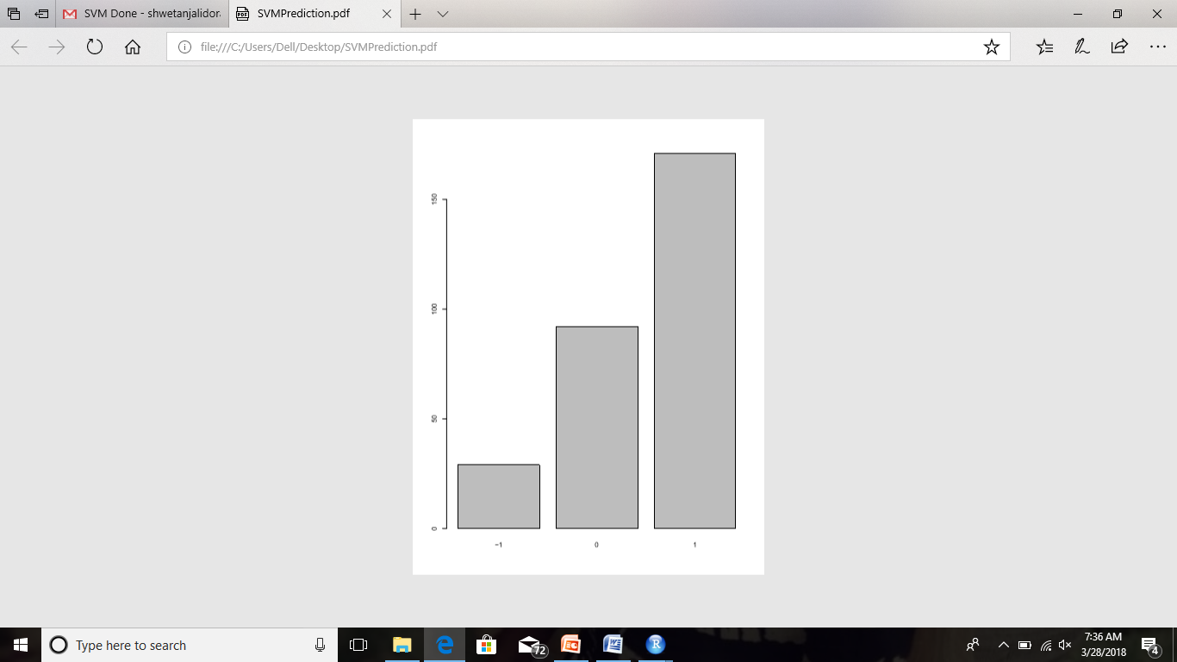
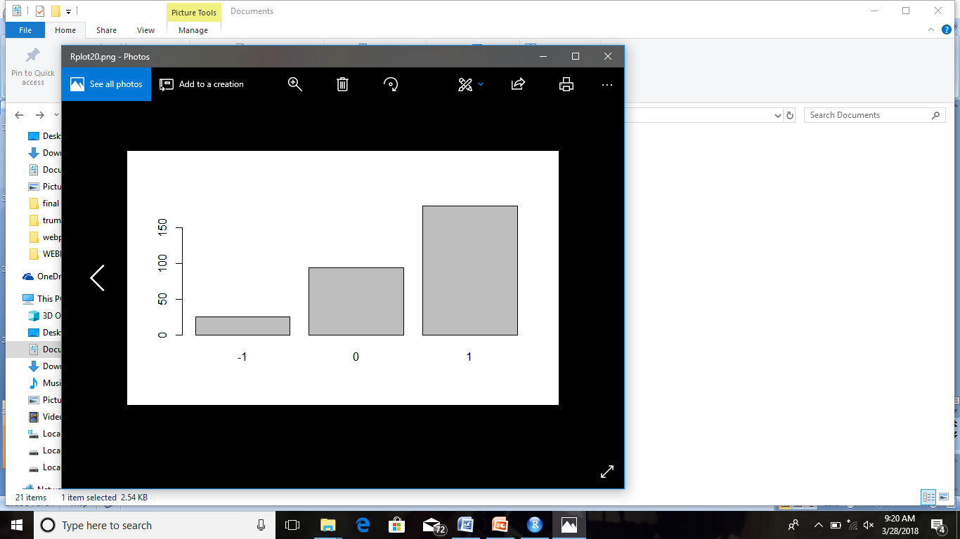
Polarity graphs of Narendra Modi and Donald Trump

Slide 40
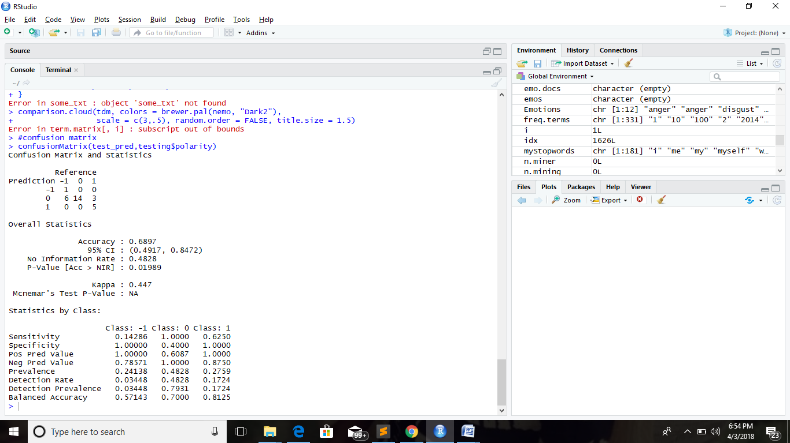
Confusion matrix of Donald Trump

Slide 41
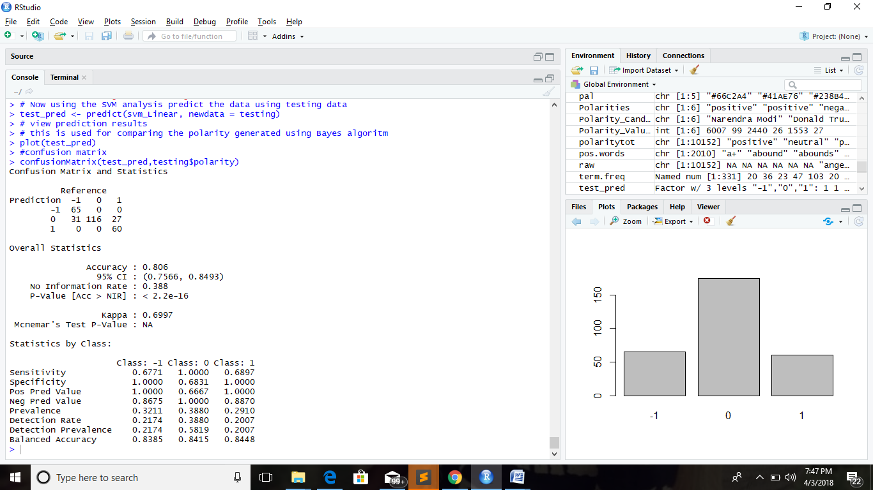
Confusion Matrix of Narendra Modi

Slide 42
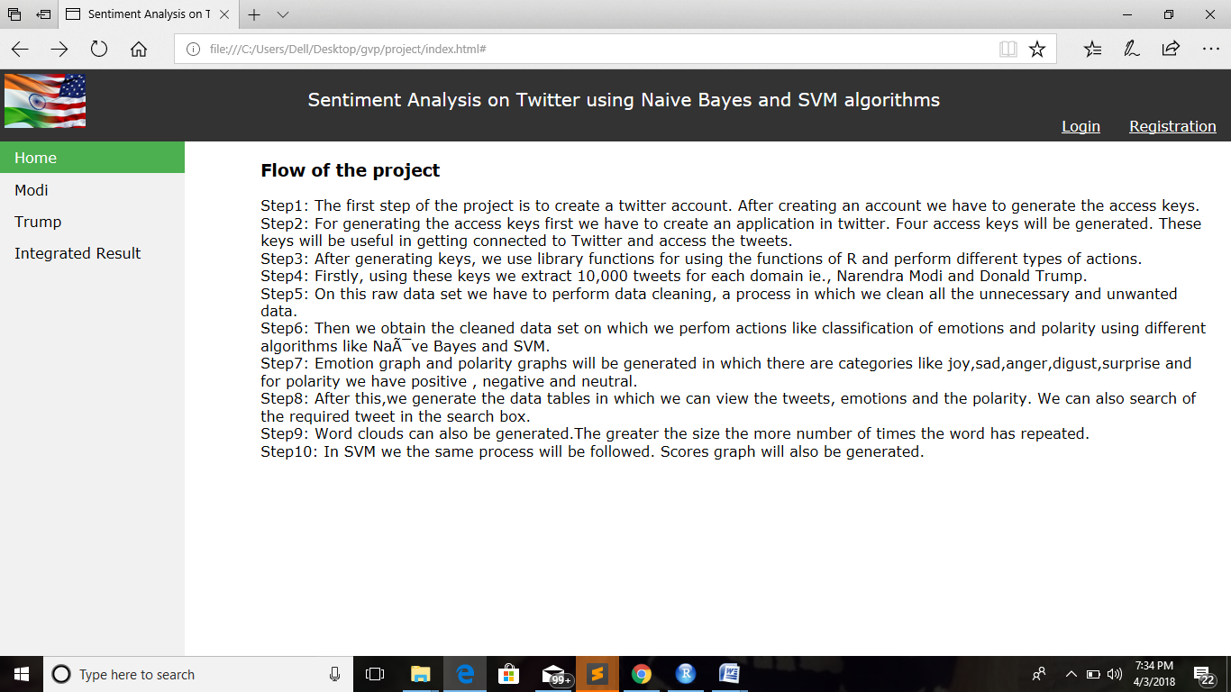
Front end Output Screens

Slide 43
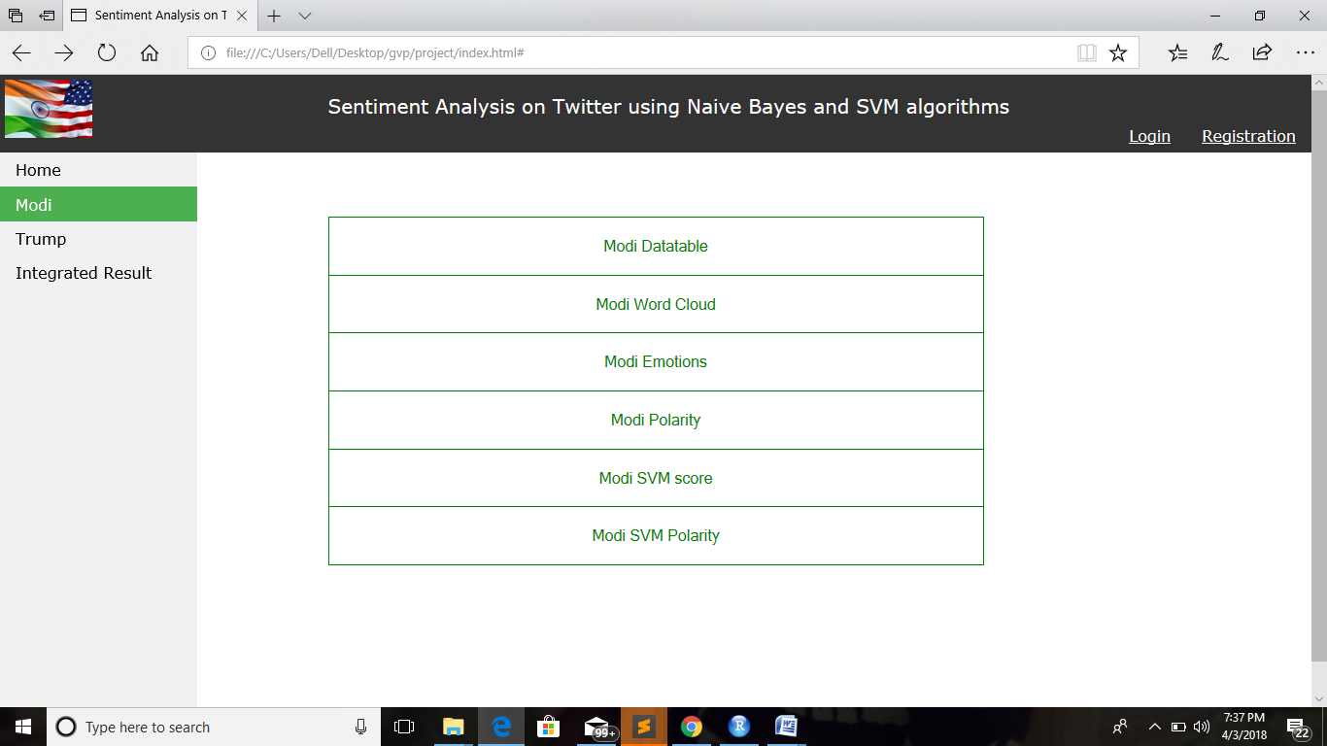
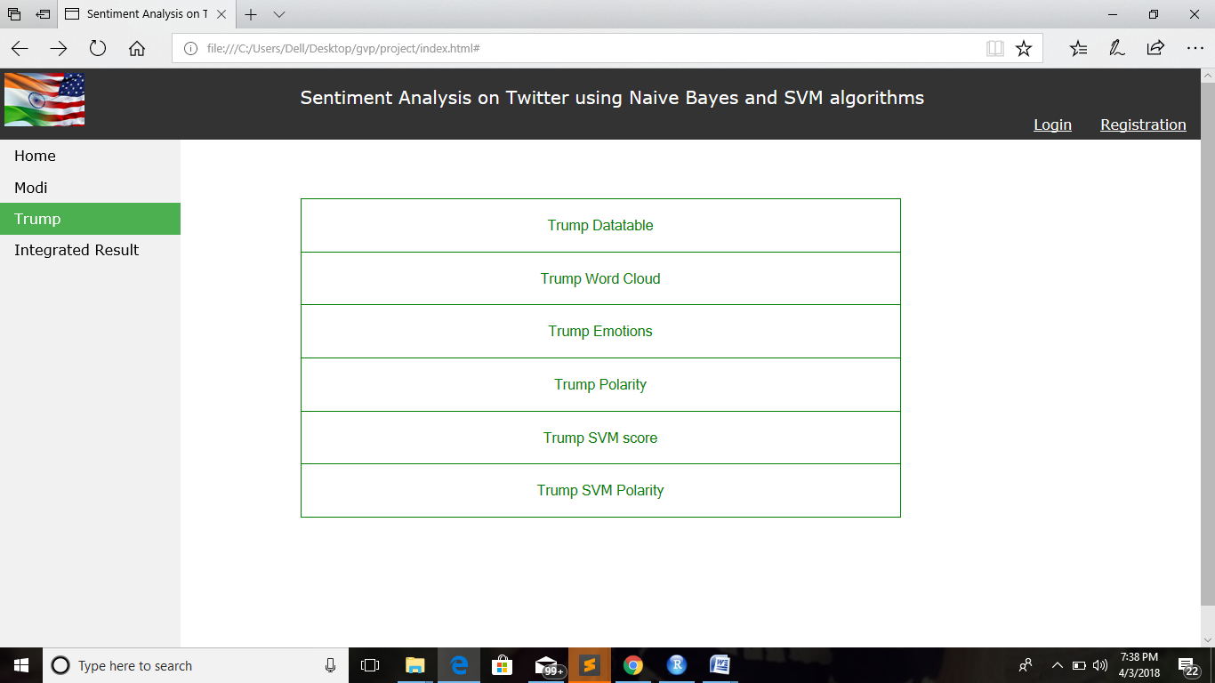

Slide 44
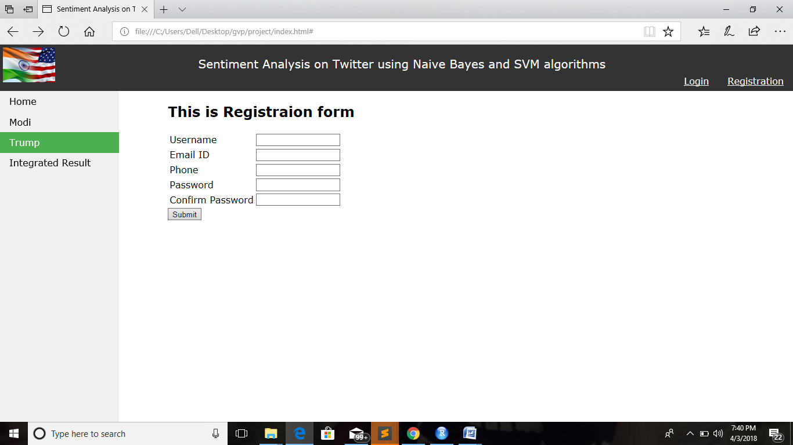
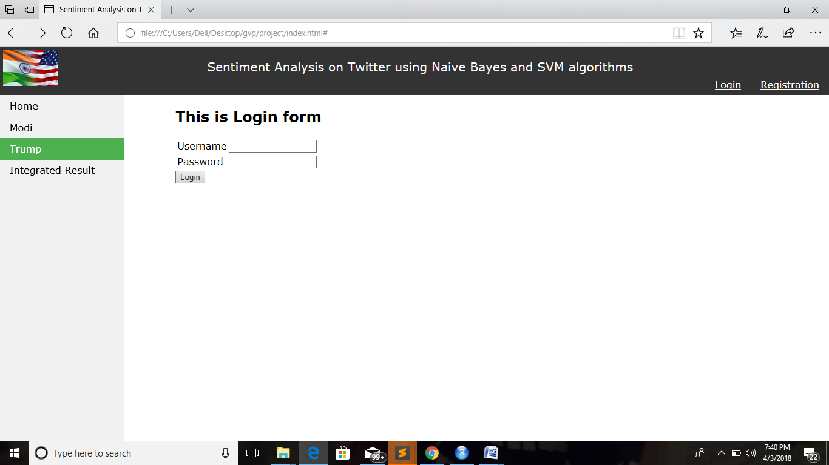

Slide 45
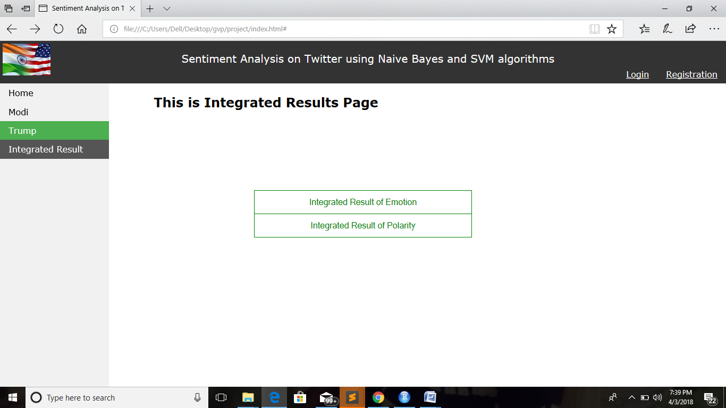
Integrated Results

Slide 46
THANK YOU

